Slide 2
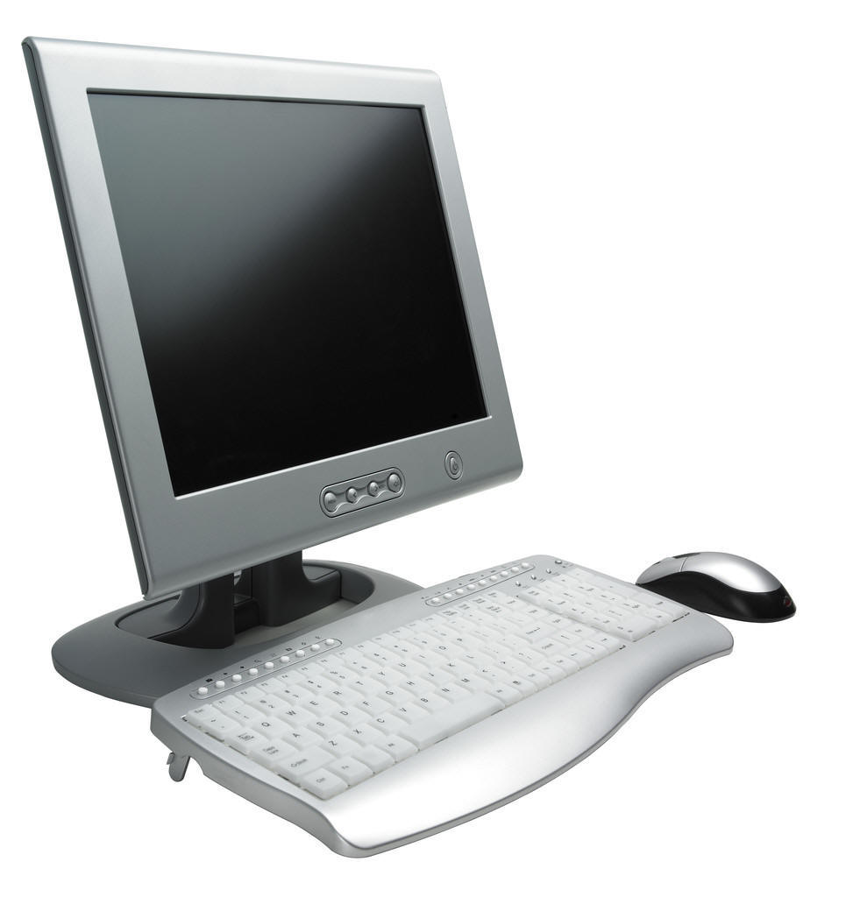
Applications of computer

Slide 3
Presentation By:
FUTURE IT
www.presenationpoint.yolasite.com
&
Designed By:
www.exploretomorrow.blogspot.com

Slide 4
History of computers
Abacus
Pascal line calculator
ENIAC(Electronic numerical integrator and calculator)

Slide 5
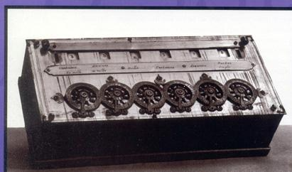
History
Abacus Pasacline

Slide 6
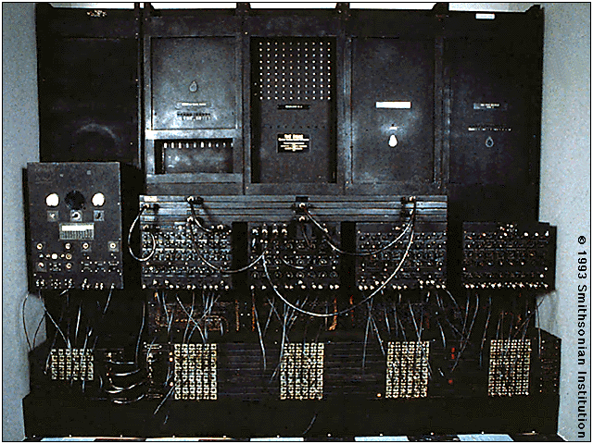
The world first digital computer
ENIAC

Slide 7
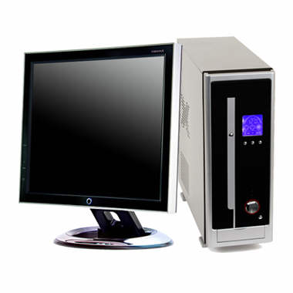
Computers
Computer is an electronic device which Takes input(data).
After that it processes the data
At the end it gives us the output

Slide 9
Let us see Application of computer in Different fields.

Slide 10
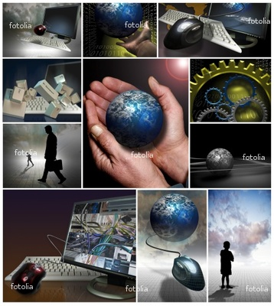
Application of computers
Education
Banking
Business
Marketing
Stock Exchange
Transportation
Space
Medical science
Military defense system
Mobile computing
Mobile

Slide 11
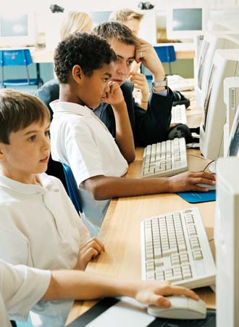
Education
Computer are used in many colleges and universities to provide the method of teaching in different ways.
Many computer based programs and software available which student s can learn to read , to count ,or to speak a foreign language.

Slide 12
Computers save time and convenience for customer.
International banking and the abilities to handle trading in multiple currencies are critical for international trade

Slide 13
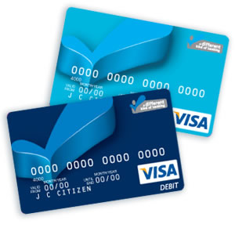
Some international banks retail purchasing can also be done by giving a credit card number
Now all banks use Atm
(Automatic teller machine)

Slide 14
Business
In every organization there are major business process that provide critical tasks such that customer bills, analyzing sales of various products.
Connects to the Whole world

Slide 15
Marketing
Marketing application provide information about the organization’s products, its distribution system.
Its advertising and personal selling activities and its pricing strategies.

Slide 16
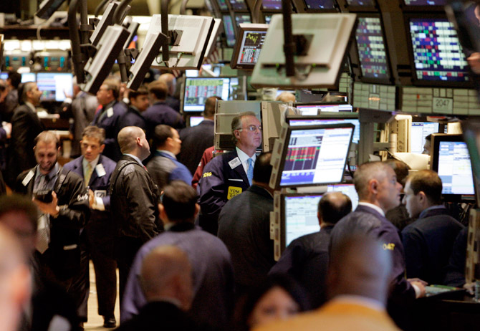
Stock Exchange
Stock exchange around the world is in transition.
Now stock market
launched the computerized
system that makes it possible
for stockbrokers to do all
electronically.
Brokers interconnected
through a data communications
network submit and receive
bids using their Computers.

Slide 17
Transportation
Airline system
In airline system computers are used to control passenger and aircrafts and vehicles
In modern fly by wire system electronic
signals from the cockpit and sent to adjust the flight

Slide 18
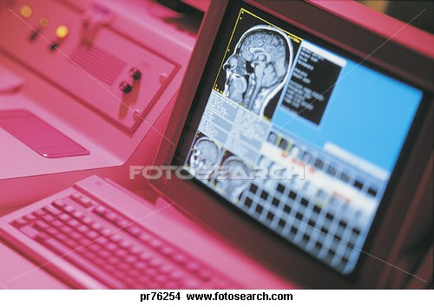
Medical
The computers are commonly used in some area of medical fields such as laboratories, researches, scanning, monitoring, pharmacy, etc.

Slide 19
Diagnoses
A scanner use electromagnetic rays use to scan body which tells us which part of body is affected by cancer or any kind o tumors.
It is also use to scan the bones an muscles to detect fracture.

Slide 20
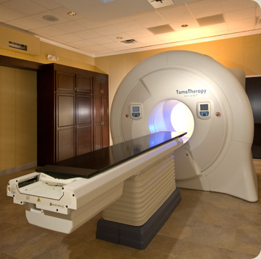
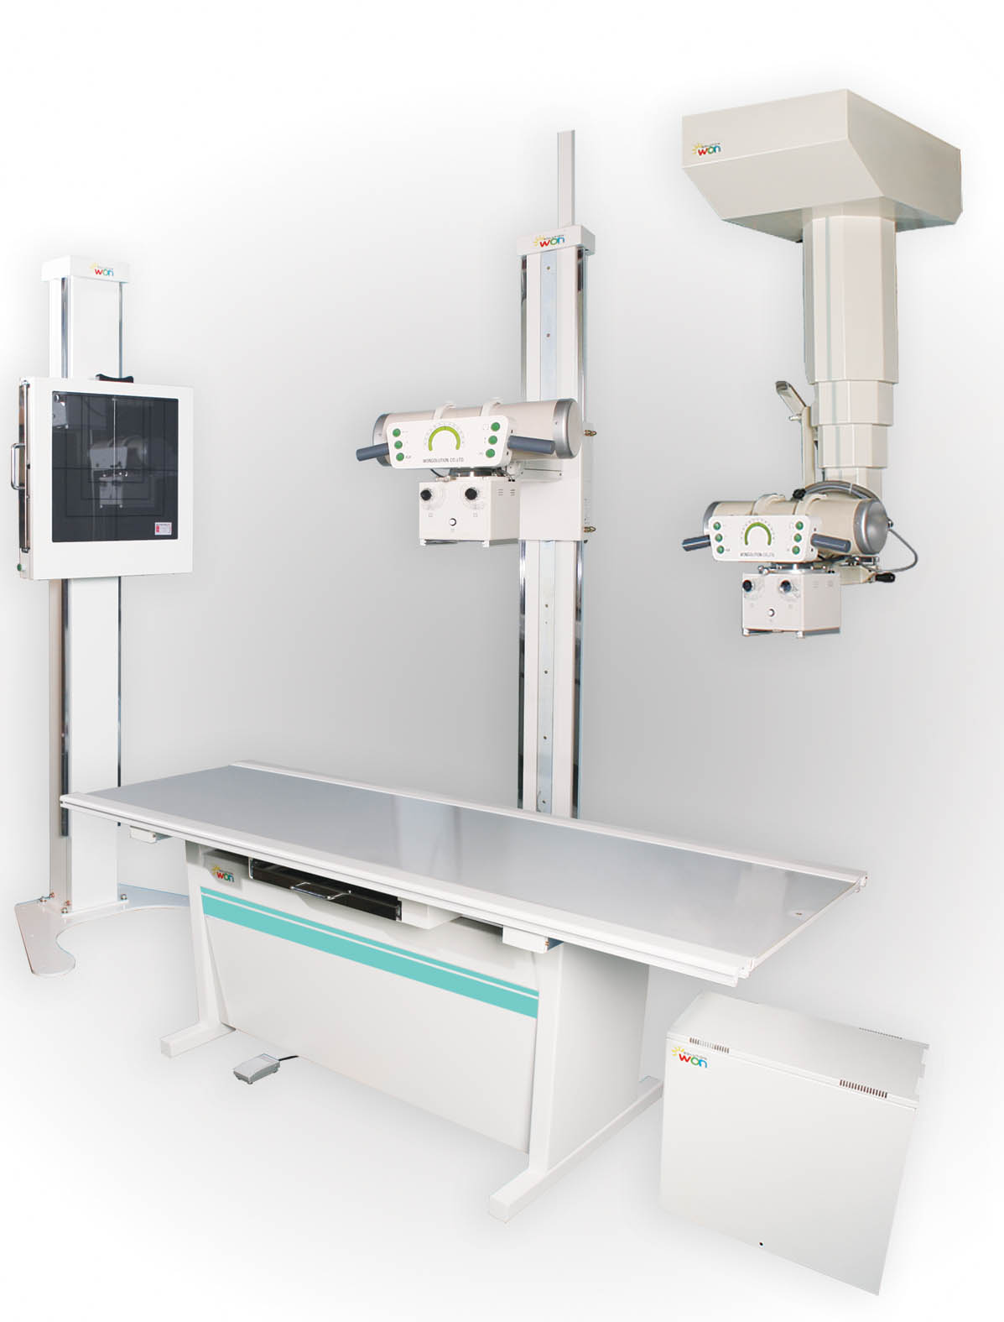
Diagnosis
Cancer Treating machine X-ray machine

Slide 21
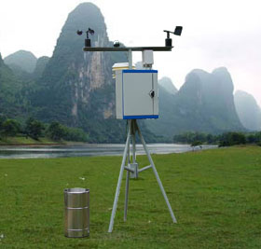
Weather forecast
Computer base weather forecasting depends on accurate collection of data from weather stations and satellites.
Weather over casting provide weather forecasting and decision making support to farmers and the flights schedule

Slide 22
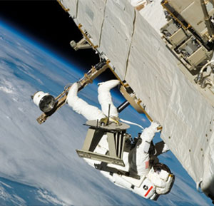
Nasa
Nasa use computers to calculate space craft and trajectories, figuring out where to aim a spacecraft.
Nasa use computers to analyze data send back from space mission and use to control guidance system and propulsion system.

Slide 23
E Commerce
E commerce(electronic commerce)
describes, buying, selling, exchanging of products, services and information via computer network
E -Mail(electronic mail)
E-mail is service use to send messages to others voice mail, system capture, store and transmit spoken messages

Slide 24
Video conferencing
Video conferencing is a type of conferencing in which video cameras and microphones capture sight and sound transmission over network.

Slide 25
Defense system
Country defense system is often based on computers.
Naval defense system
Army Defense system
Air Defense system

Slide 26
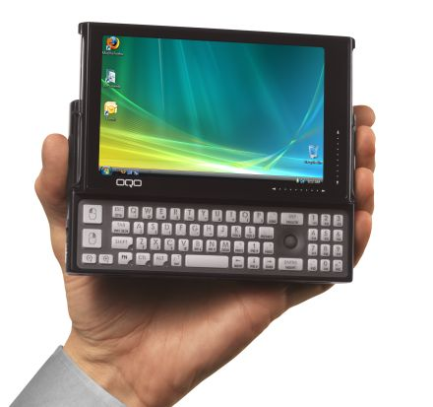
Mobile computing
Mobile computing is a generic term describing one's ability to use technology while moving, as opposed to portable computers.
Laptop
Palmtops
Notebook laptops

Slide 27
Mobiles
In computer science , a mobile agent is a composition of computer software and data ... migrate between computers at any time during their execution. ...

Slide 28
Future of computer
In a few year, every where you turn, a computer will be there to assist, to inform simply to play with.

